Slide 1
Electronics & Electricity
Unit 8 – Schematic Builds
Section 3 – 555 Timer Chip

Slide 2
Schematic Builds
555 timer chip

Slide 3
The big idea
Breadboard circuit prototyping
Circuit schematics
Ohm’s Law application
The 555 timer chip

Slide 4
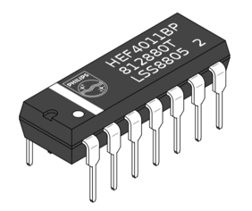
Integrated Circuit

Slide 5
555 timer chip
Circuit that has been shrunk down in size to make a little chip
Same exact components however just scaled wayyyyyy down
Always check the datasheet to see what your circuit does
Typically the manufacturer and and model can be found at the top of the integrated circuit

Slide 6
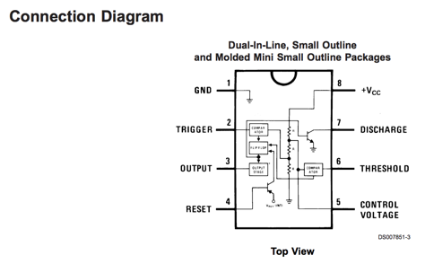

Slide 7
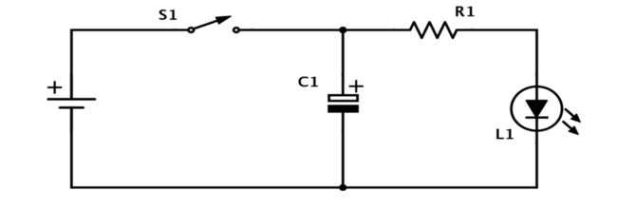
The Metronome

Slide 8
